Slide 1
ELECTRONIC
CIRCUIT

Slide 2
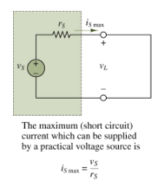
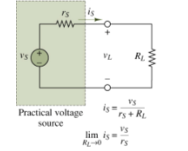
Practical Voltage Source

Slide 3
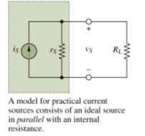
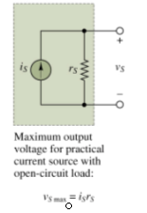
Practical Current Source

Slide 4
Circuit Topology Fundamental

Slide 5
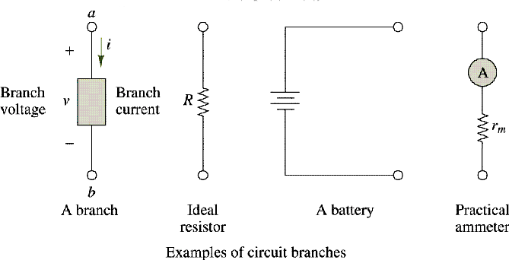
Definition of a branch

Slide 6
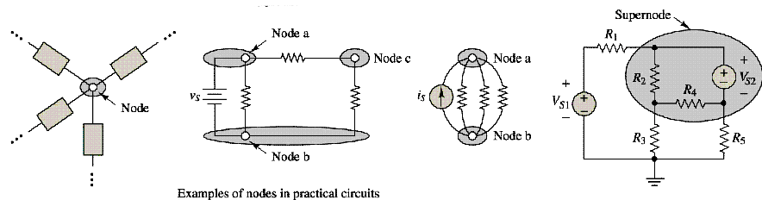
Definitions of node and supernode

Slide 7
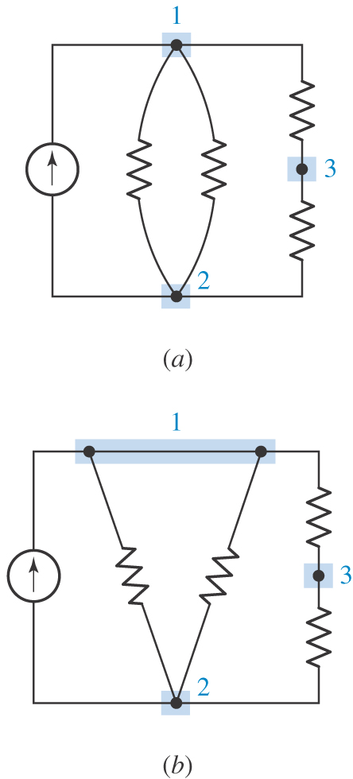
(a) A circuit containing three nodes and five branches.
(b) Node 1 is redrawn to look like two nodes; it is still one node.

Slide 8
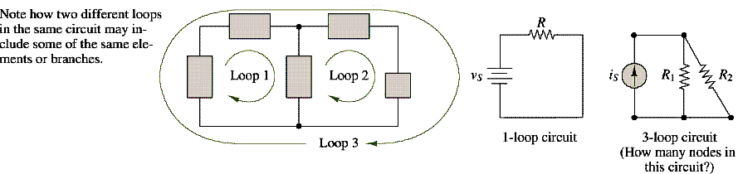
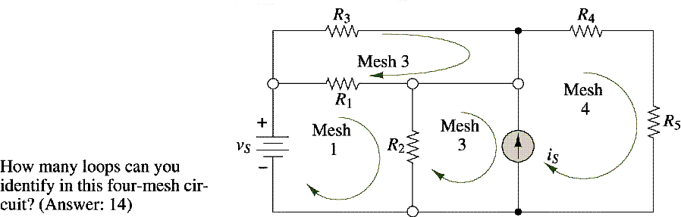
Definition of a loop
Definition of a mesh

Slide 9
Series Circuits and
Kirchhoff’s Voltage Law

Slide 10
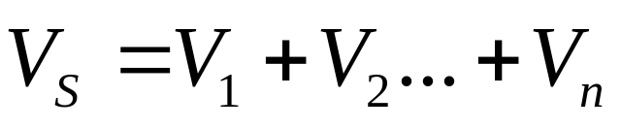
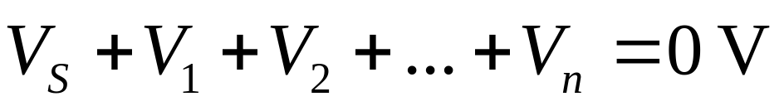
Voltage Relationships: Kirchhoff’s Voltage Law
Kirchhoff’s Voltage Law
  The sum of the component voltages in a series circuit must equal the source voltage
  1840 – German Physicist, Gustav Kirchhoff
  Actual wording – The algebraic sum of the voltages around a closed loop is zero
  The following equation takes polarity into account

Slide 11
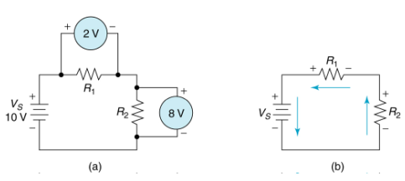
Kirchhoff’s Voltage Law,
Example:
V_{S} = +10V, V₁ = +2V, V₂ = +8V

Slide 12
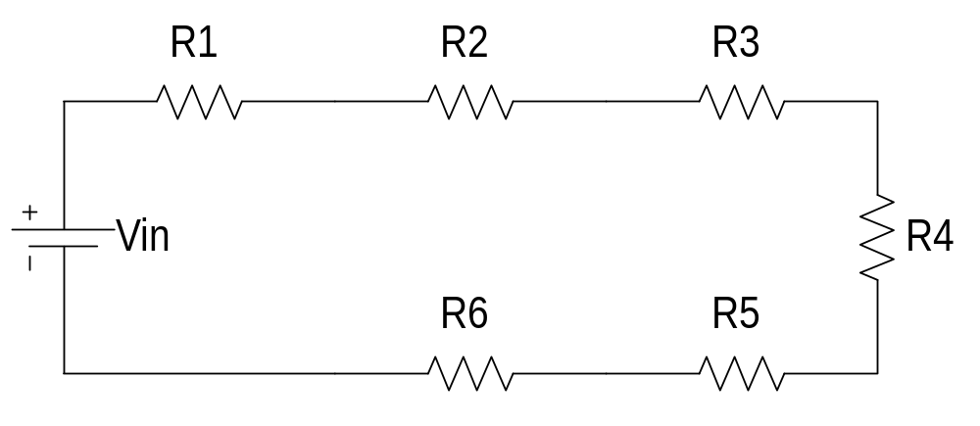
Series Circuit Characteristics
Series Circuit – a circuit that contains only one current path

Slide 13
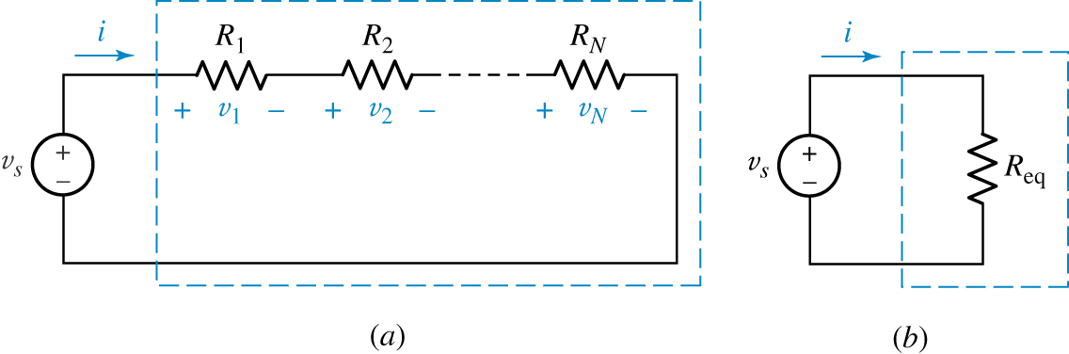
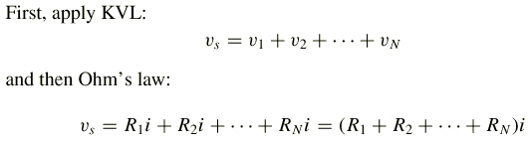
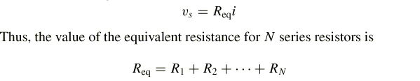
(a) Series combination of N resistors. (b) Electrically equivalent circuit.

Slide 14
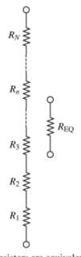
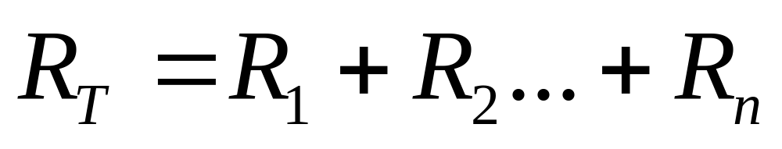
Series Circuit Characteristics
Total Series Resistance
where
R_{T} = the total circuit resistance
R_{n} = the highest-numbered resistor
in the circuit

Slide 15
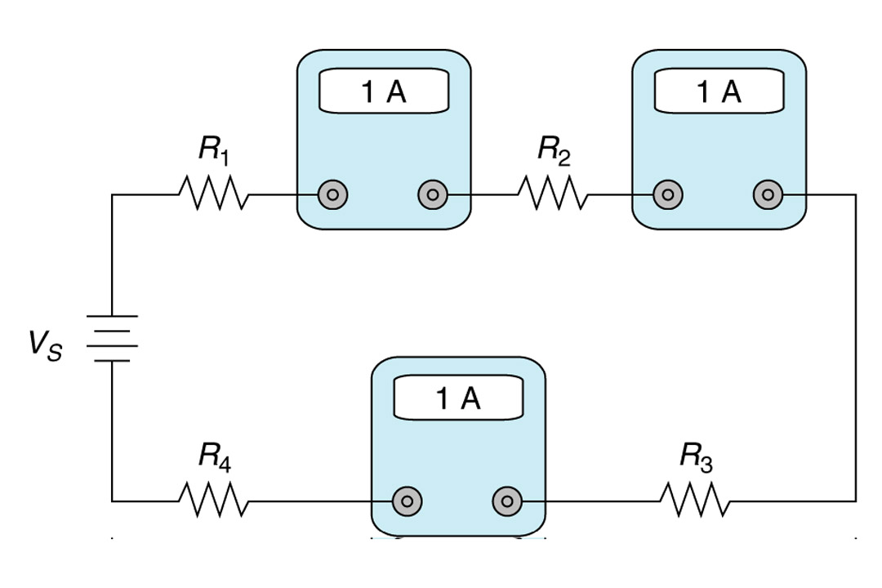
Series Circuit Characteristics
Current Characteristics – the current at any point in a series circuit must equal the current at every other point in the circuit
Insert Figure 4.5

Slide 16
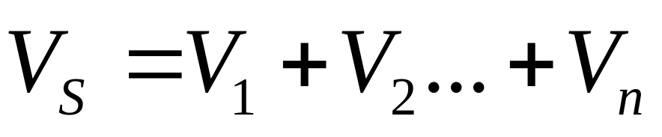
Series Circuit Characteristics
Voltage Characteristics
where
V_{S} = the source (or total) voltage
V_{n} = the voltage across the highest numbered resistor in the circuit

Slide 17
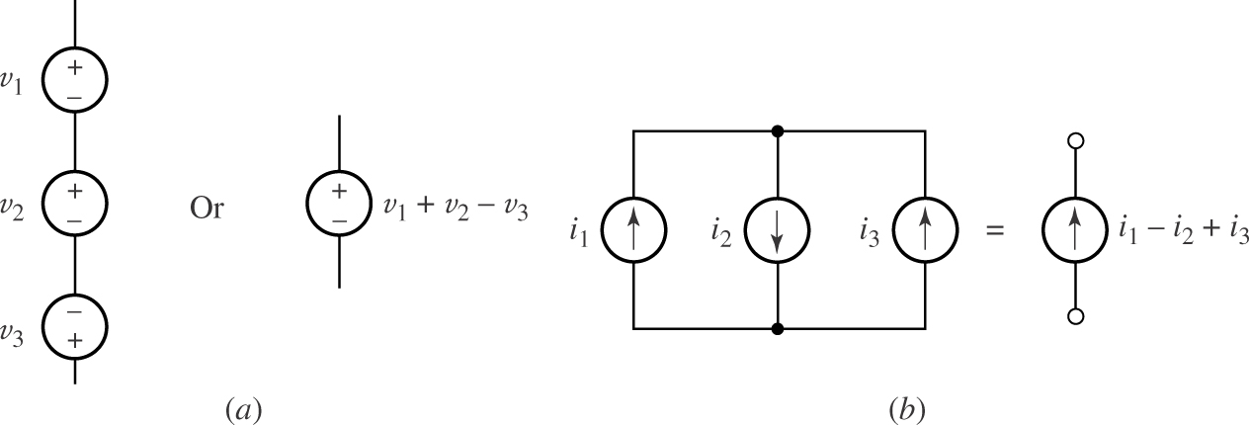
(a) Series connected voltage sources can be replaced by a single source.
(b) Parallel current sources can be replaced by a single source.

Slide 18
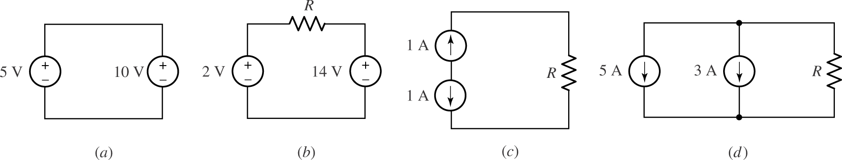
Examples of circuits with multiple sources, some of which are “illegal” as they violate Kirchhoff’s laws.

Slide 19
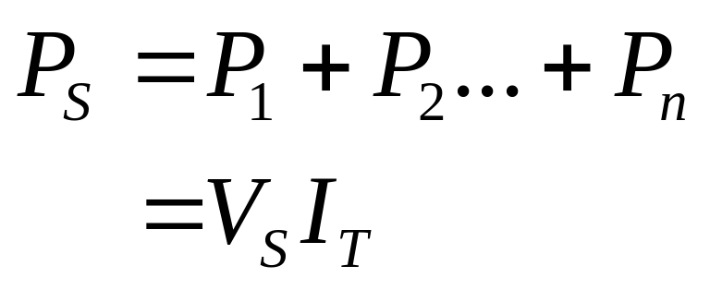
Series Circuit Characteristics
Power Characteristics
where
P_{S} = the source (or total) voltage
P_{n} = the power that is dissipated across the highest numbered resistor in the circuit

Slide 20
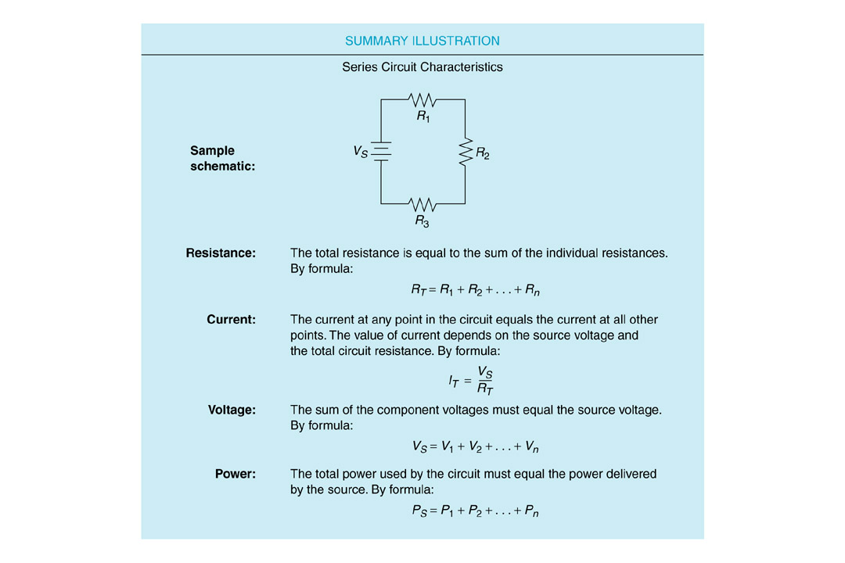
Series Circuit Characteristics
Insert Figure 4.10

Slide 21
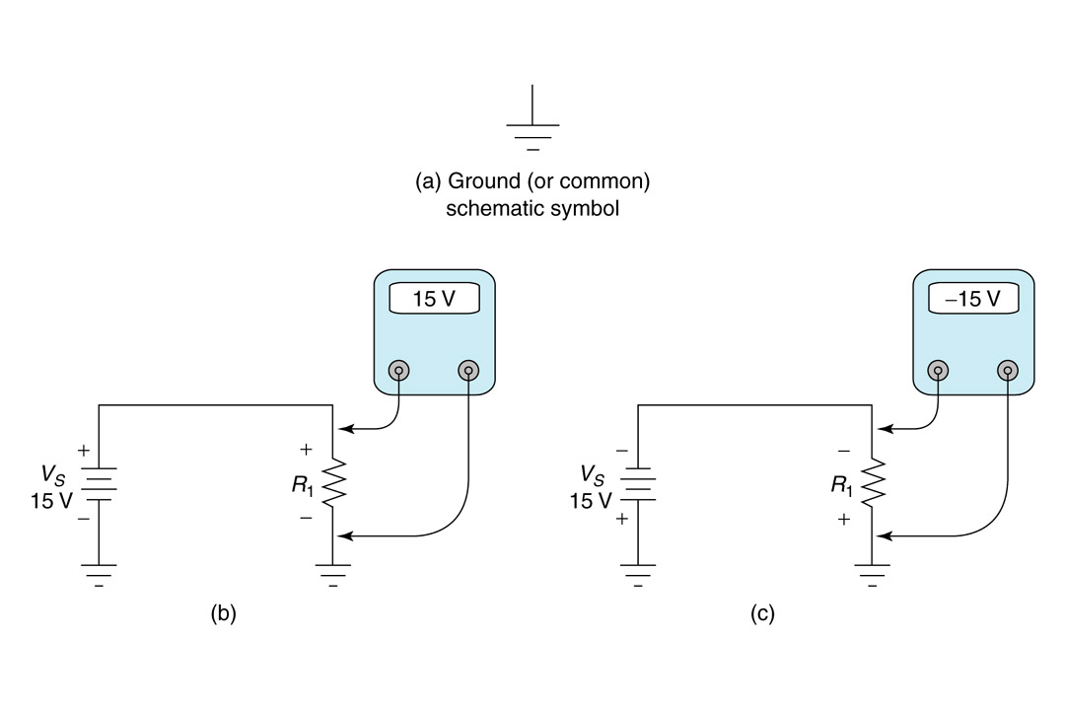
Voltage References
Voltage References - Circuits have a point that serves as the 0 V reference (ground)
Insert Figure 4.12

Slide 22
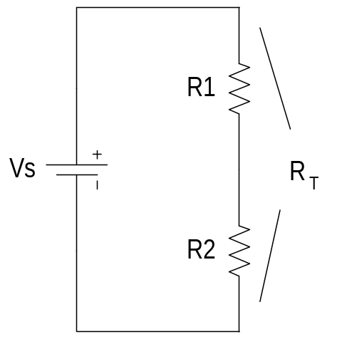
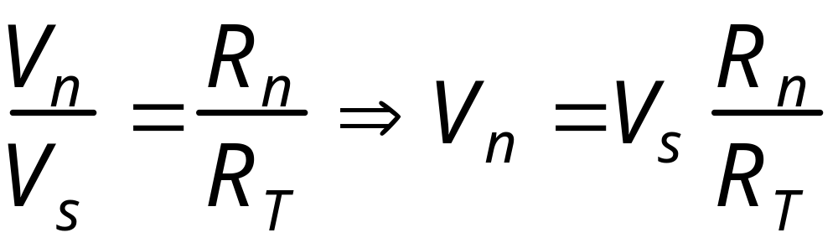
Voltage Divider
The Voltage Divider Relationship
  Voltage Divider – often used to analyze a series circuit
where
R_{n} = the resistor of interest
V_{n} = the voltage drop across R_{n}
(where n is the component number)

Slide 23
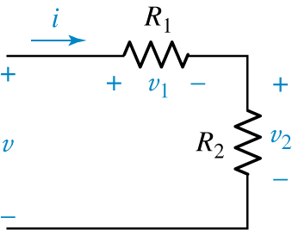
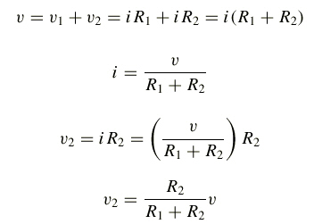

We may find v₂ by applying KVL and Ohm’s law:
so
Thus,
An illustration of voltage division.
or
For a string of N series resistors, we may write:

Slide 24
Source Resistance: A Practical Consideration
  Ideal Voltage Source – maintains a constant output voltage regardless of the resistance of its load
  Real Voltage Source – internal resistance causes a decrease in load resistance results in a decrease in the source voltage

Slide 25
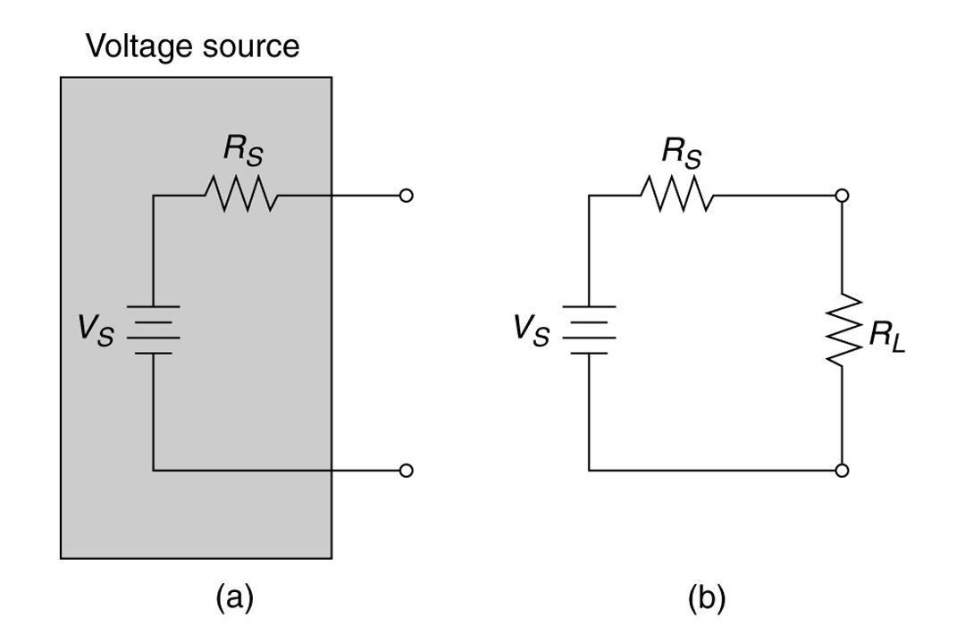
Source Resistance: A Practical Consideration (Continued)
Insert Figure 4.20

Slide 26
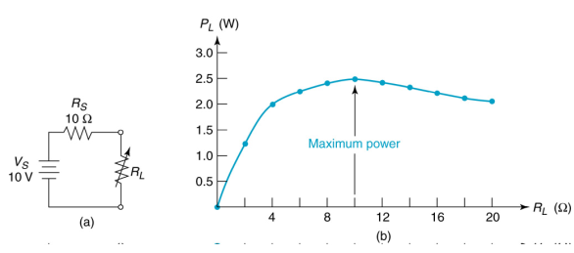
Maximum Power Transfer Theorem
maximum power transfer from a voltage source to its load occurs when the load resistance is equal to the source resistance

Slide 27
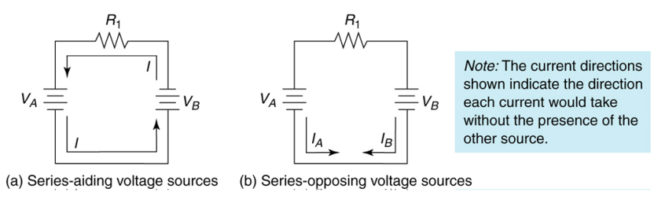
Series-Connected Voltage Sources
Series-Aiding Voltage Sources – the total voltage equals the sum of the voltages
Series-Opposing Voltage Sources – the total voltage equals the difference of the voltages

Slide 28
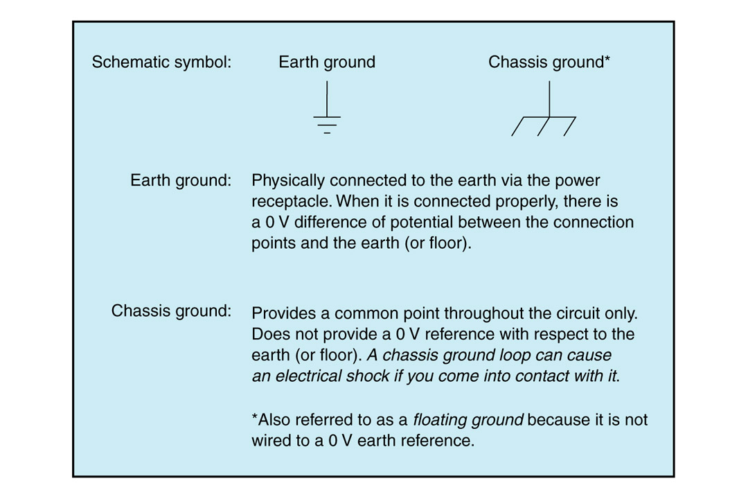
Earth Ground Versus Chassis Ground
Insert Figure 4.28

Slide 29
Parallel Circuits and
Kirchholf’s Current Law

Slide 30
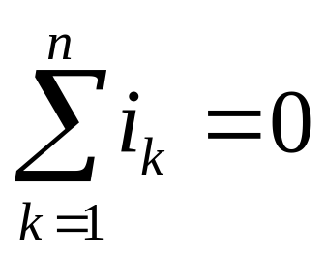
Current Relationships: Kirchhoff’s Current Law
Kirchhoff’s Current Law:
  The algebraic sum of the currents entering and leaving a point must equal zero
  In other words, the total current leaving a point must equal the total current entering that point
i
i
2
1
i
3

Slide 31
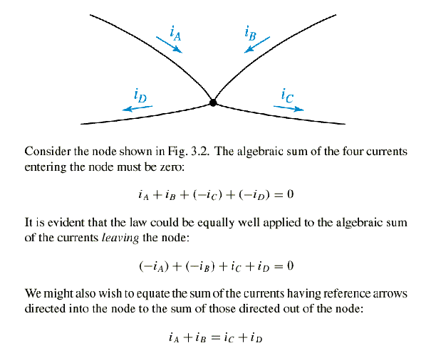

Slide 32
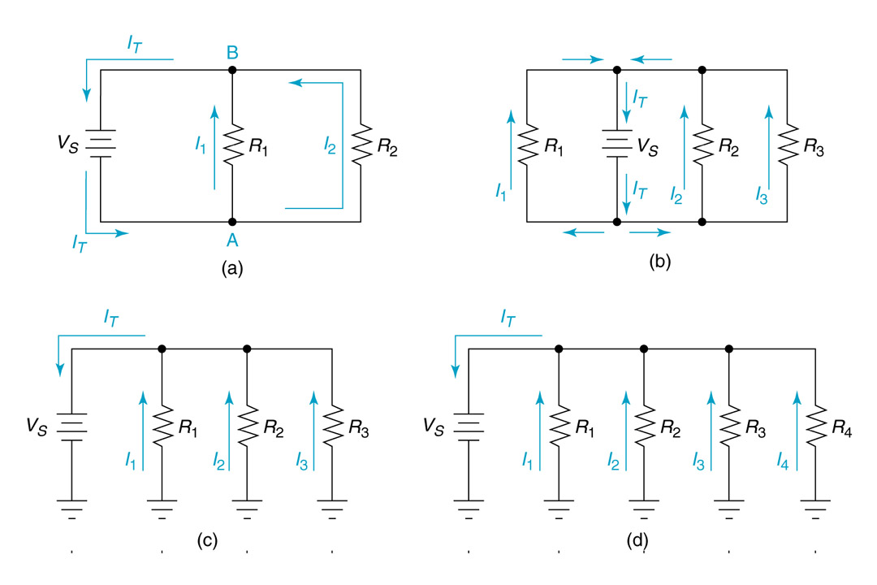
Parallel Circuit Characteristics
Parallel Circuit – a circuit that provides more than one current path between any two points
Insert Figure 5.1

Slide 33
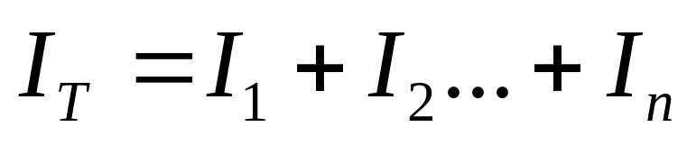
Parallel Circuit Characteristics
Current Characteristics
where
I_{n} = the current through the highest-numbered branch in the circuit

Slide 34
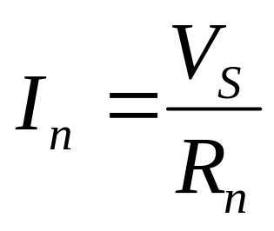
Parallel Circuit Characteristics
Voltage and Current Values
  Voltage across each component is equal
  Current through each branch is determined by the source voltage and the resistance of the branch.

Slide 35
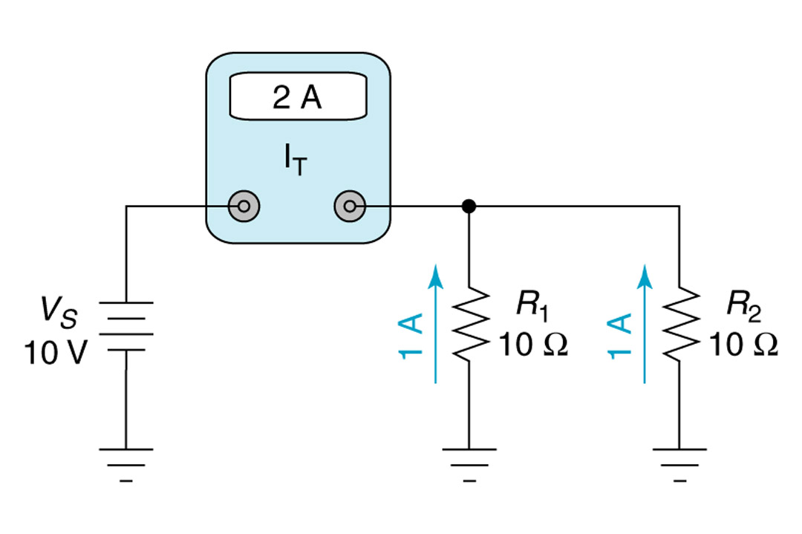
Parallel Circuit Characteristics
Resistance Characteristics – the total circuit resistance is always lower than any of the branch resistance values
Insert Figure 5.5

Slide 36
Parallel Circuit Characteristics
Power Characteristics
  Total Power – sum of the power dissipation values for the individual components
  The lower value of the branch resistance, the higher percentage of the total power it dissipates (opposite that of series circuits)

Slide 37
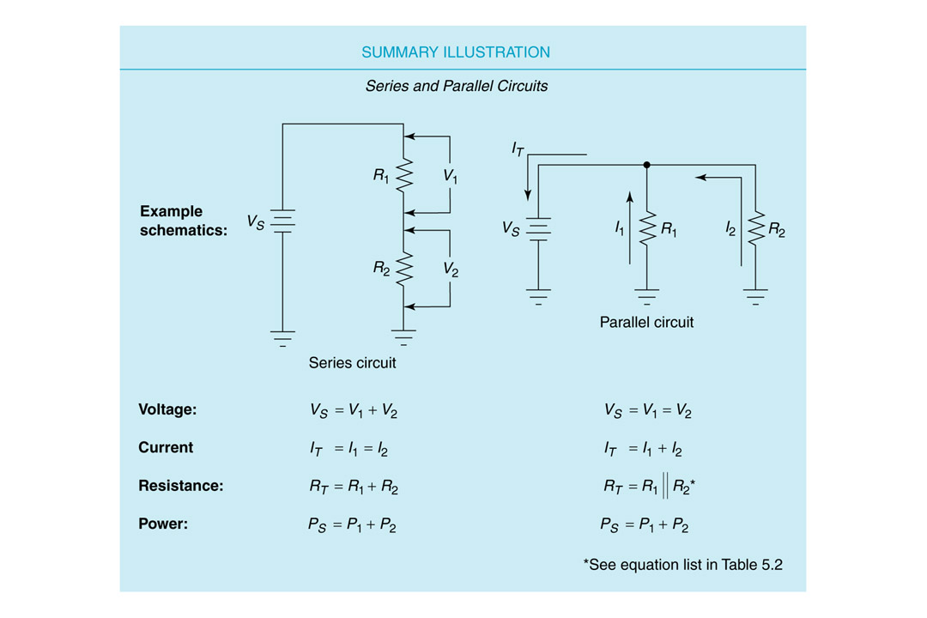
Parallel Circuit Characteristics
Insert Figure 5.6

Slide 38
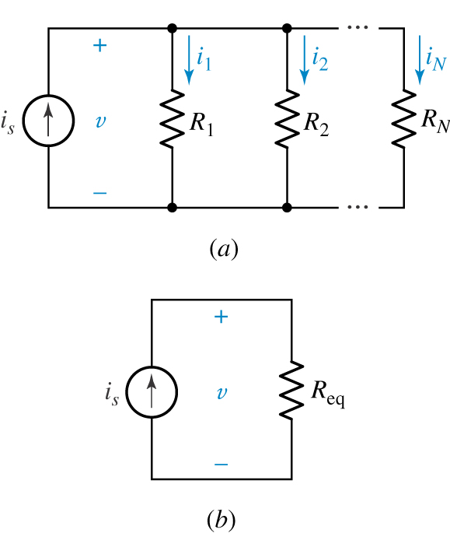
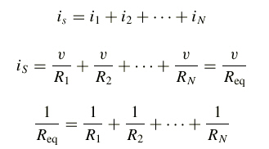
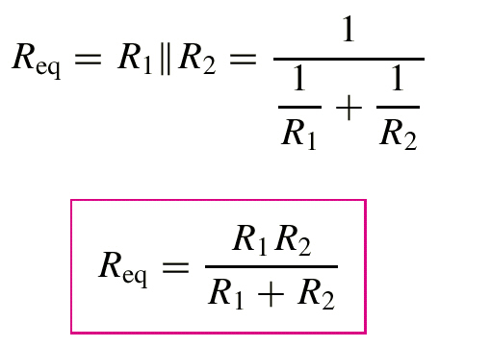
Example:
Beginning with a simple KCL equation,
or
Thus,
A special case worth remembering is
(a) A circuit with N resistors in parallel. (b) Equivalent circuit.

Slide 39
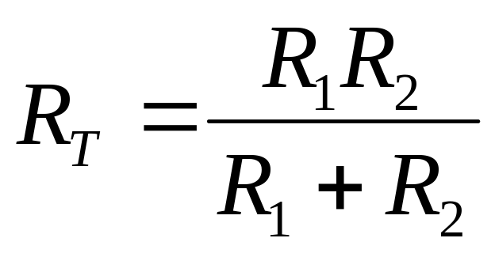
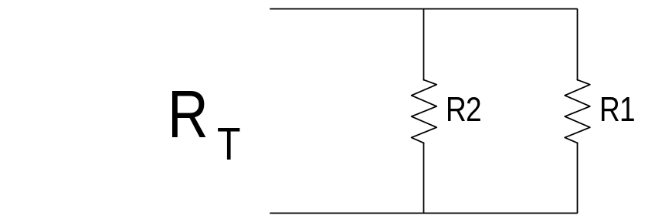
Parallel Resistance Relationships
Calculating Total Resistance: The Product-Over-Sum Method

Slide 40
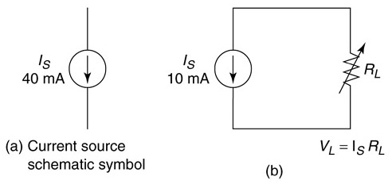
Current Sources
a source that is designed to provide an output current value that remains relatively constant over a wide range of load resistance values
Insert Figure 5.12

Slide 41
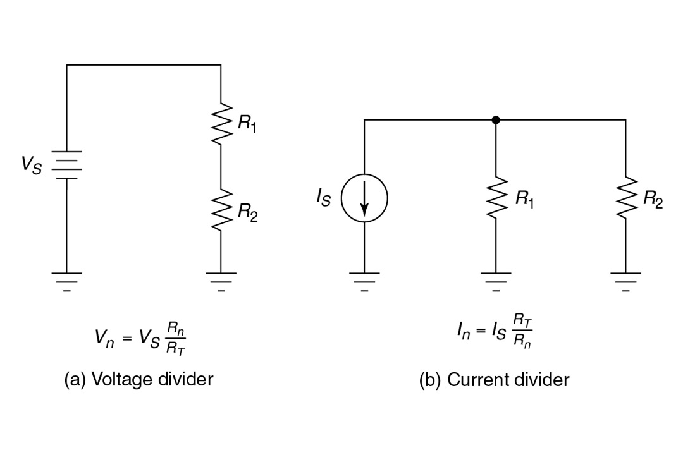
Current Dividers
Current Dividers – the source current is divided among the branches

Slide 42
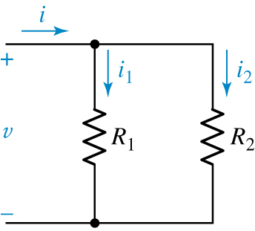
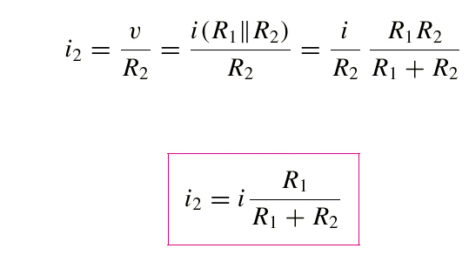
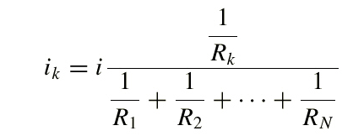
The current flowing through R₂ is
or
An illustration of
current division.
For a parallel combination of N resistors, the current through R_{k} is

Slide 43
Practical Current Sources:
The Effects of Source Resistance
  Ideal Current Source – constant current and infinite internal resistance
  Real Current Source – current varies for a change in load resistance and internal resistance is not infinite
  Internal resistance is usually much greater than the load resistance

Slide 44
Series-Parallel Circuits

Slide 45

Series-Parallel Circuits
Connecting Series Circuits in Parallel
Insert Figure 6.3

Slide 46

Series-Parallel Circuits
Connecting Parallel Circuits in Series
Insert Figure 6.5

Slide 47



Analyzing Series-Parallel Circuits

